Slide 1
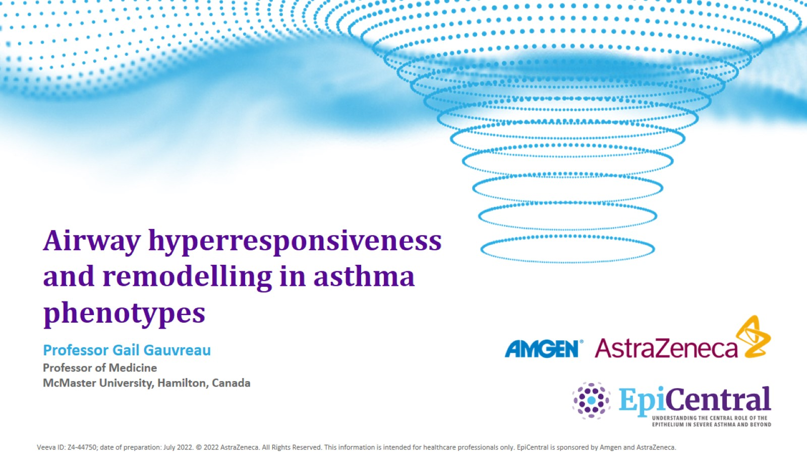
Airway hyperresponsiveness and remodelling in asthma phenotypes

Slide 2

Conflicts of interest disclosure

Slide 3
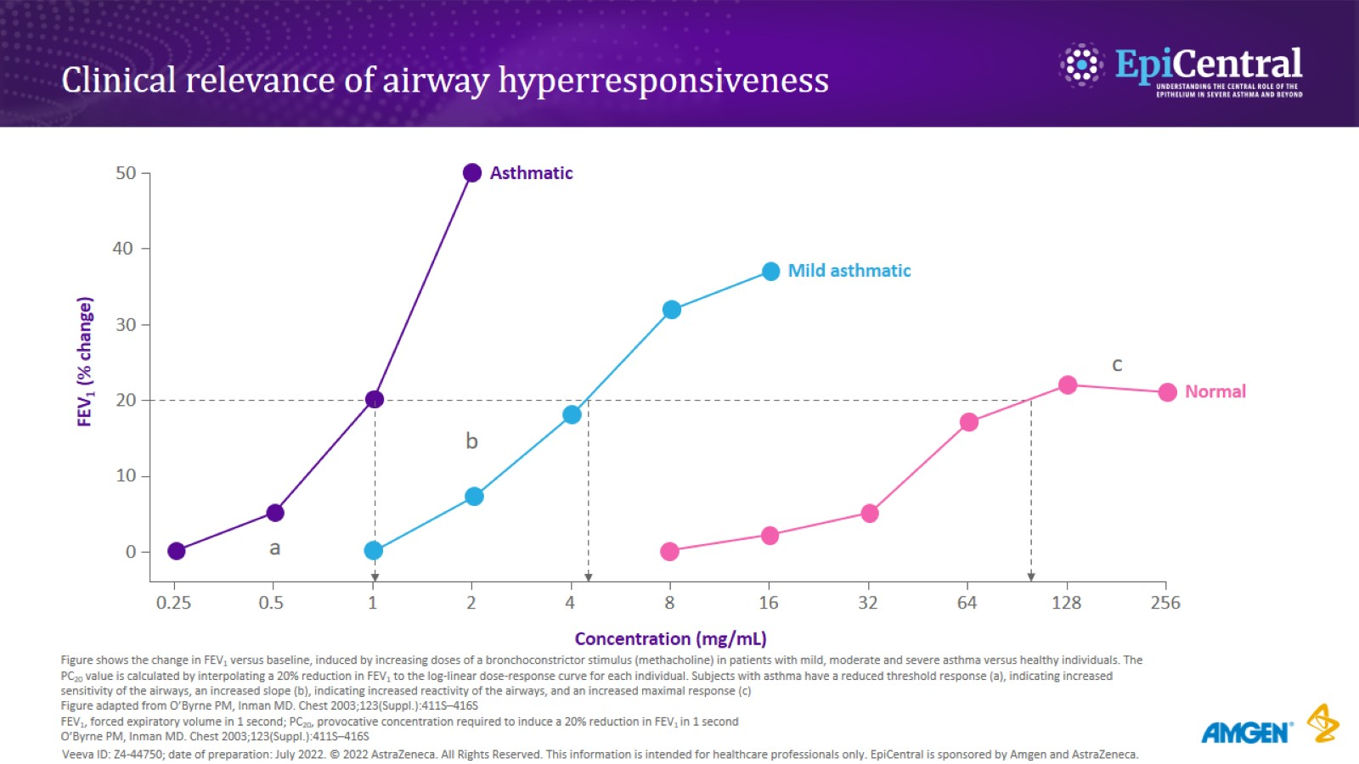
Clinical relevance of airway hyperresponsiveness

Slide 4
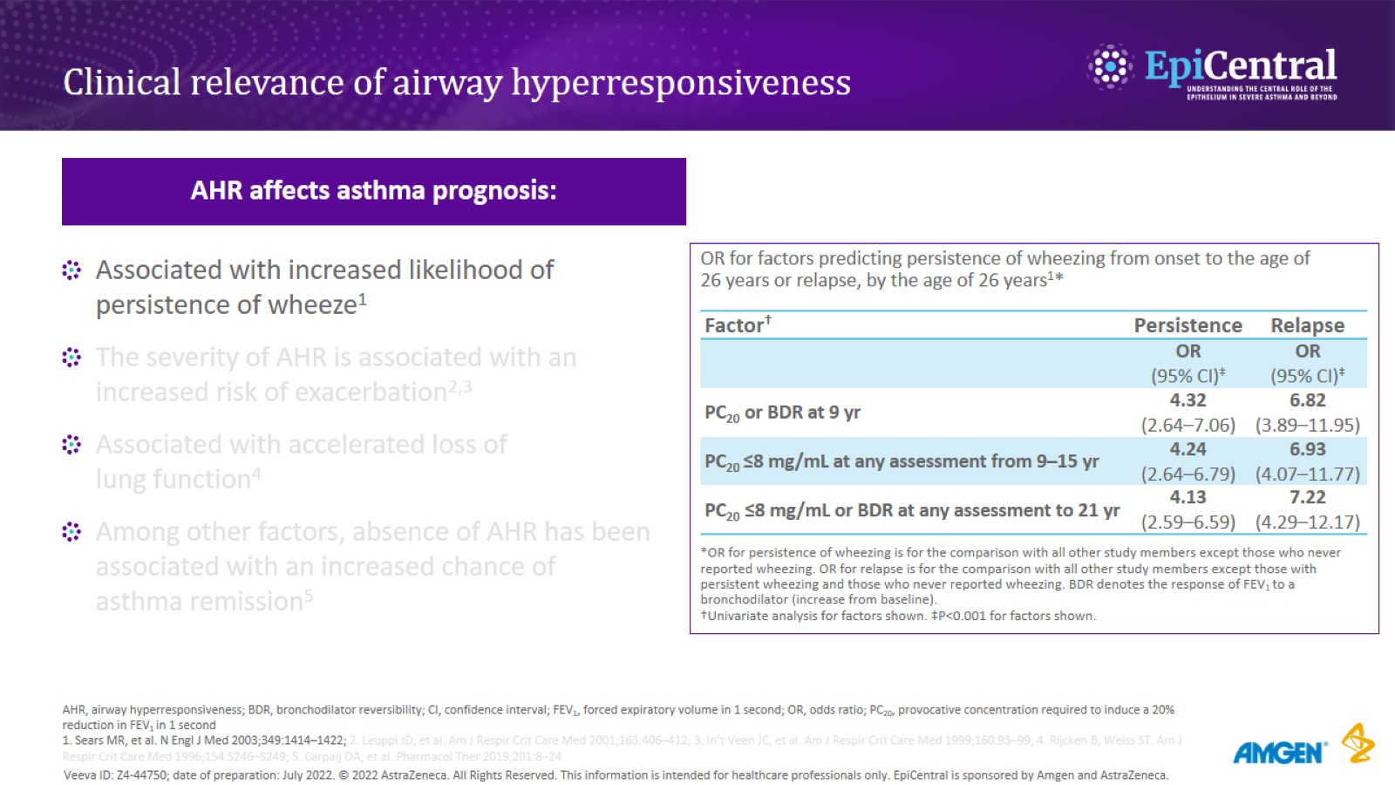
Clinical relevance of airway hyperresponsiveness

Slide 5
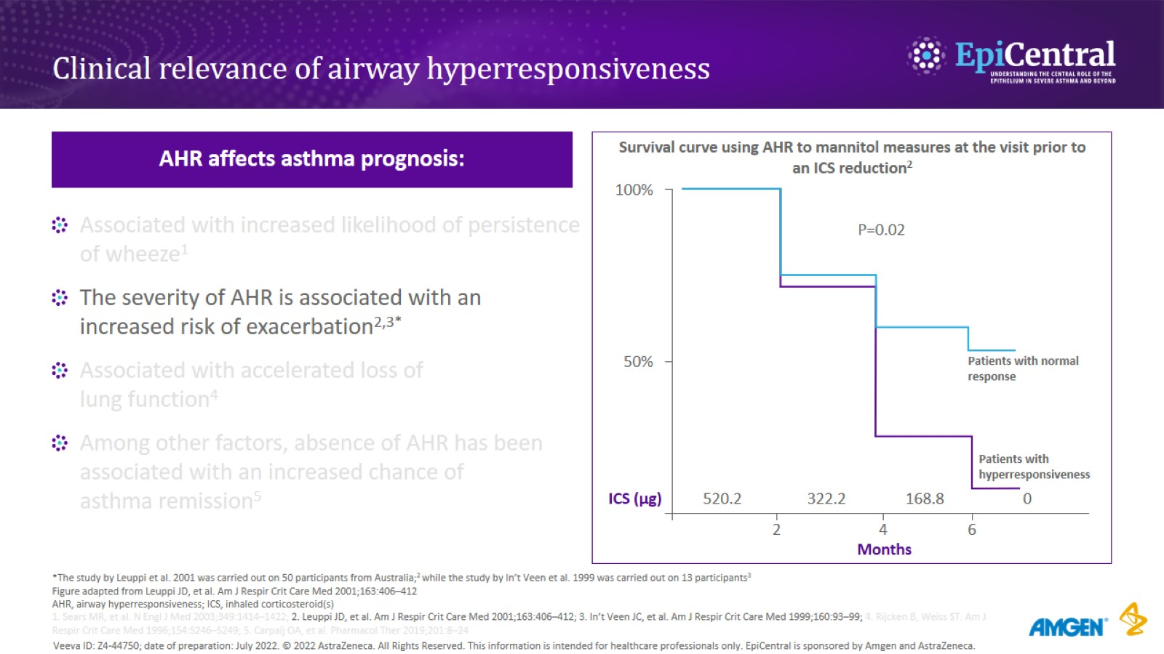
Clinical relevance of airway hyperresponsiveness

Slide 6
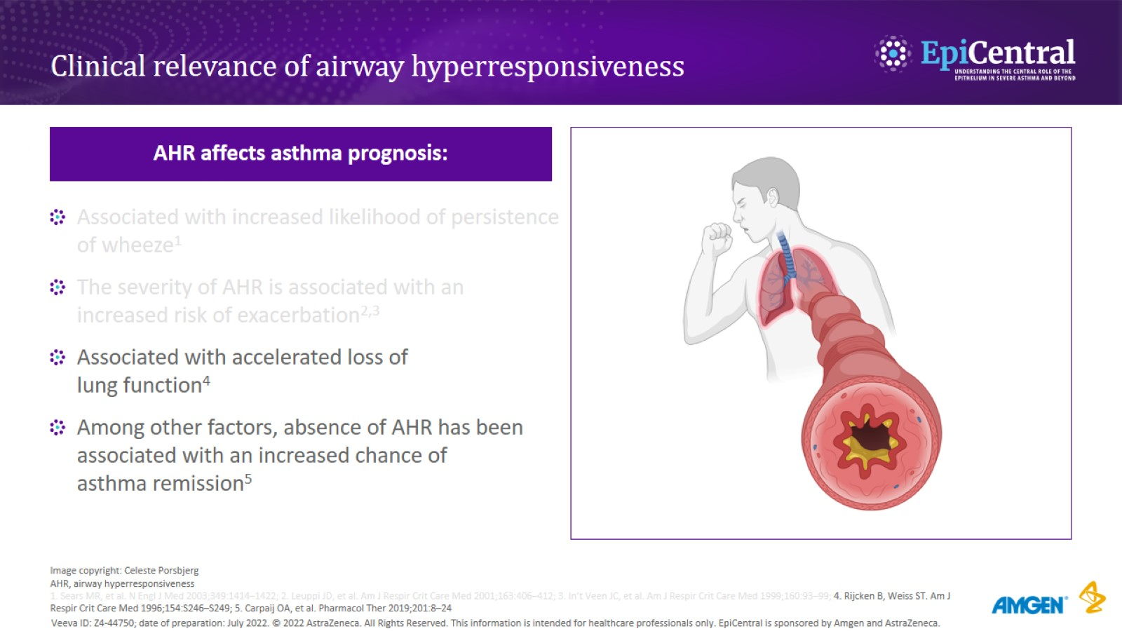
Clinical relevance of airway hyperresponsiveness

Slide 7
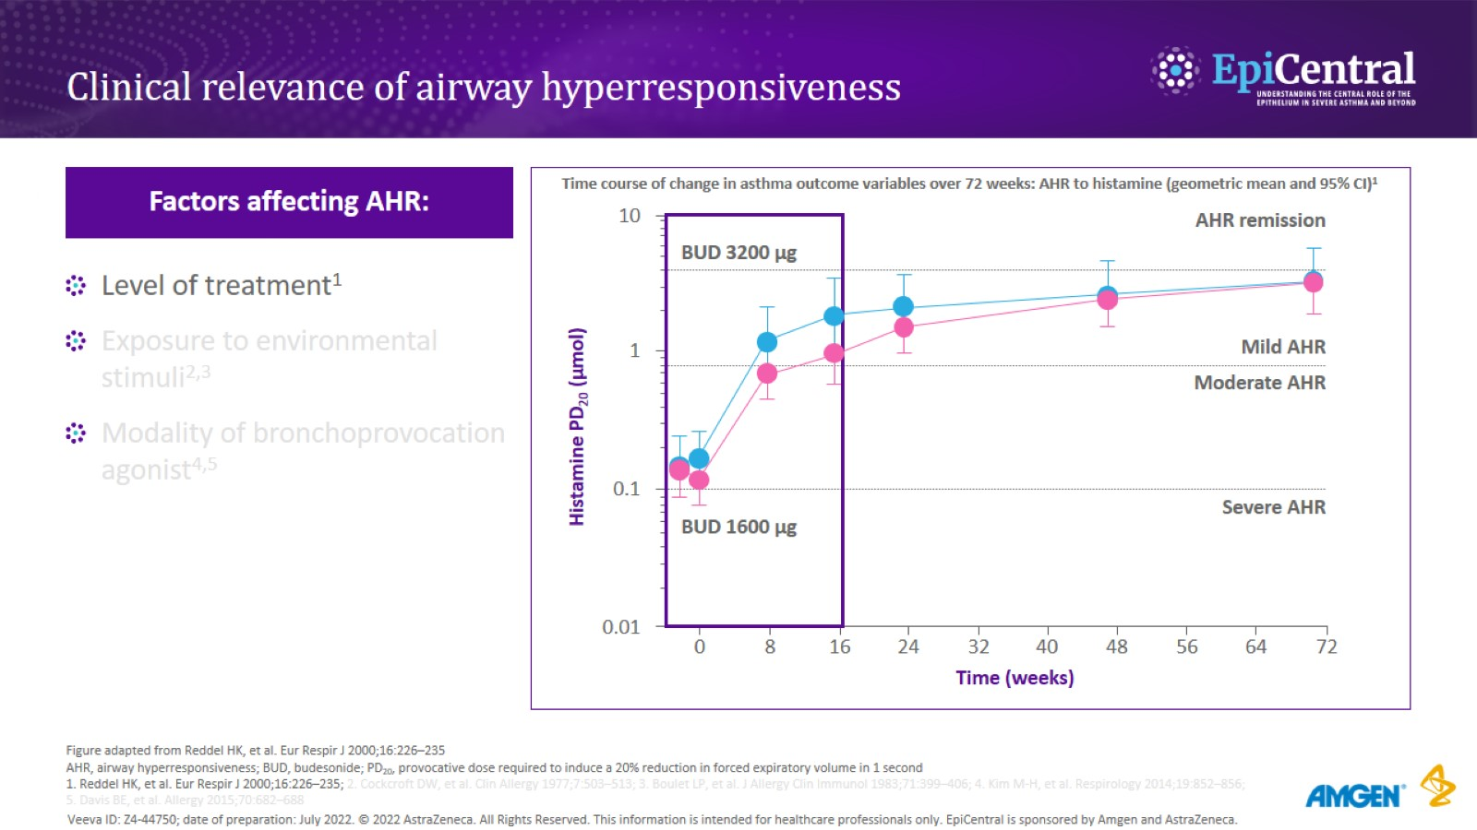
Clinical relevance of airway hyperresponsiveness

Slide 8
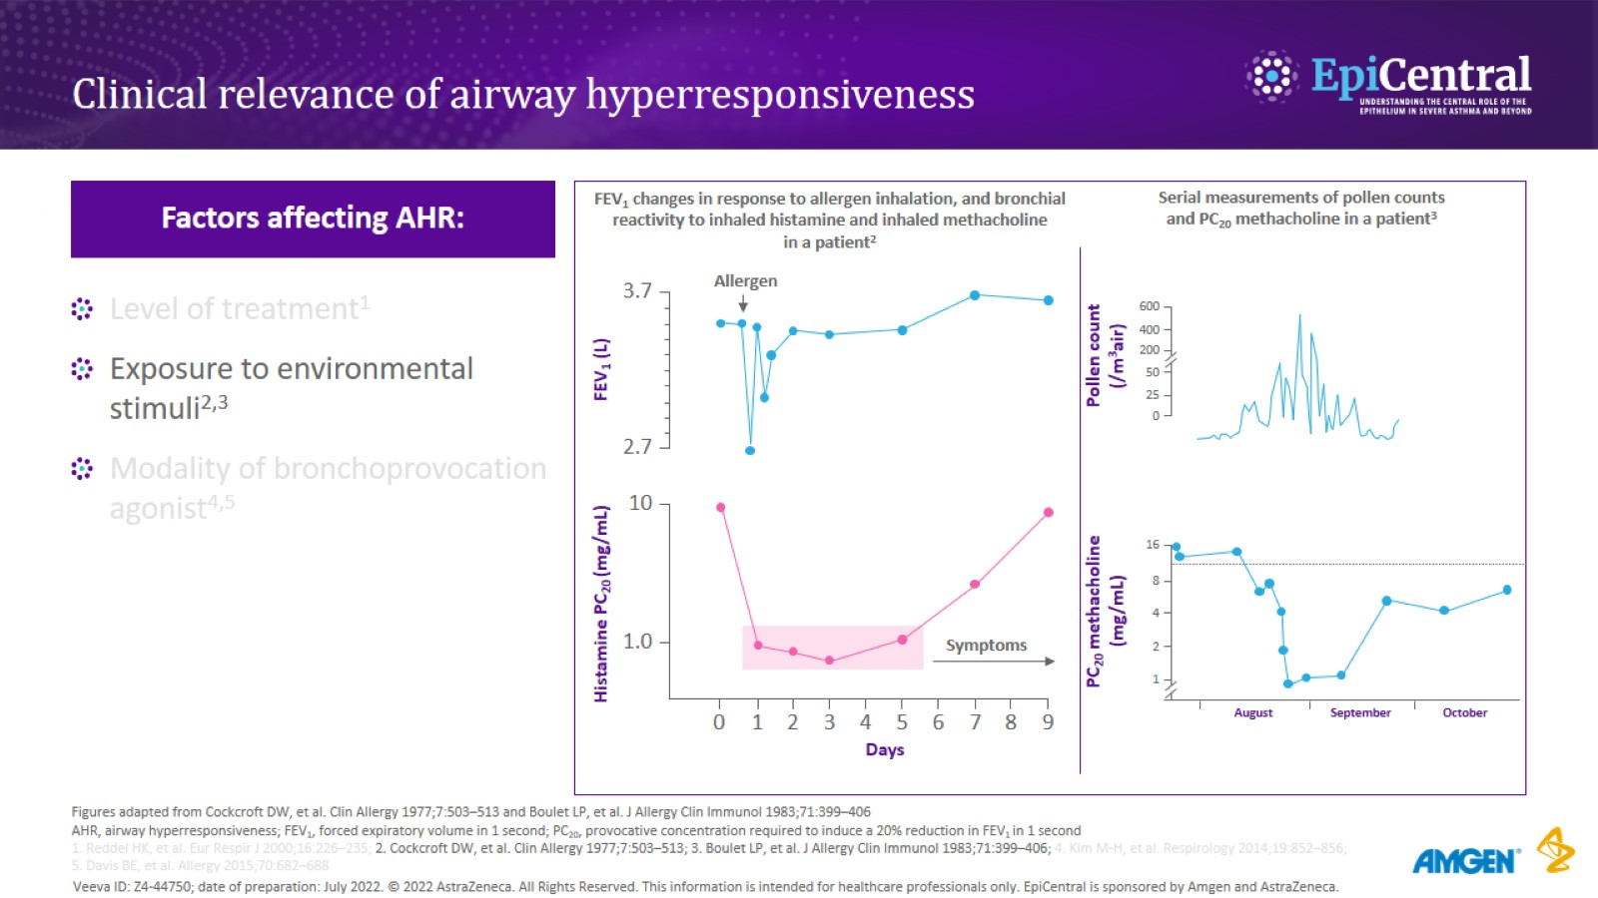
Clinical relevance of airway hyperresponsiveness

Slide 9
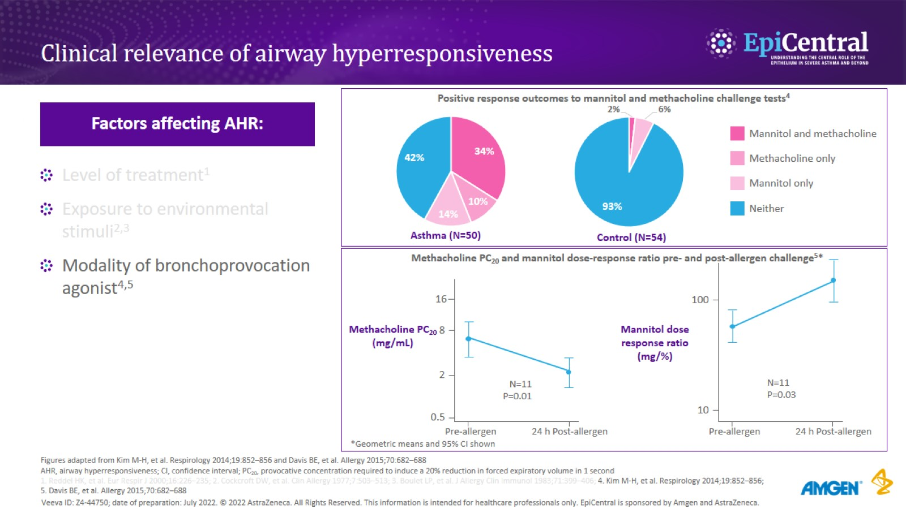
Clinical relevance of airway hyperresponsiveness

Slide 10
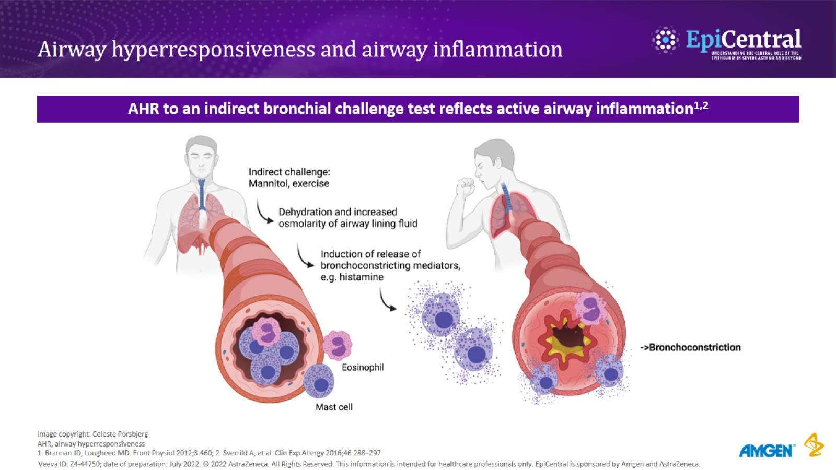
Airway hyperresponsiveness and airway inflammation

Slide 11
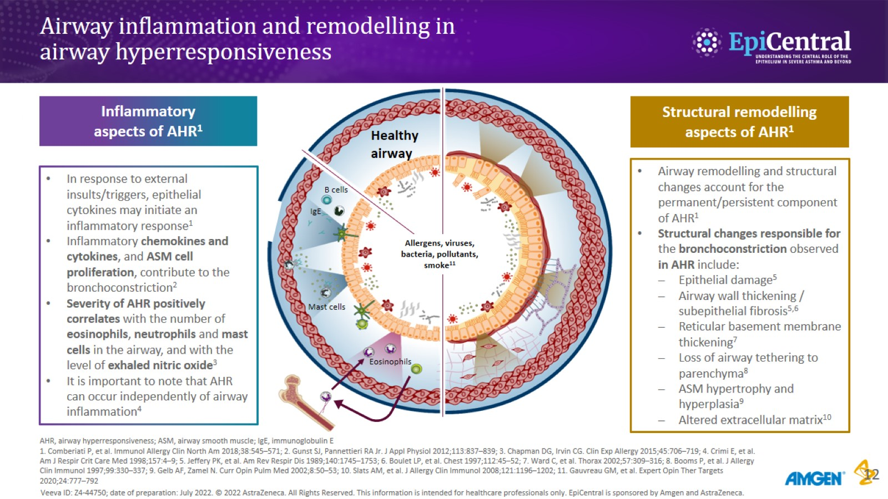
Airway inflammation and remodelling in airway hyperresponsiveness

Slide 12
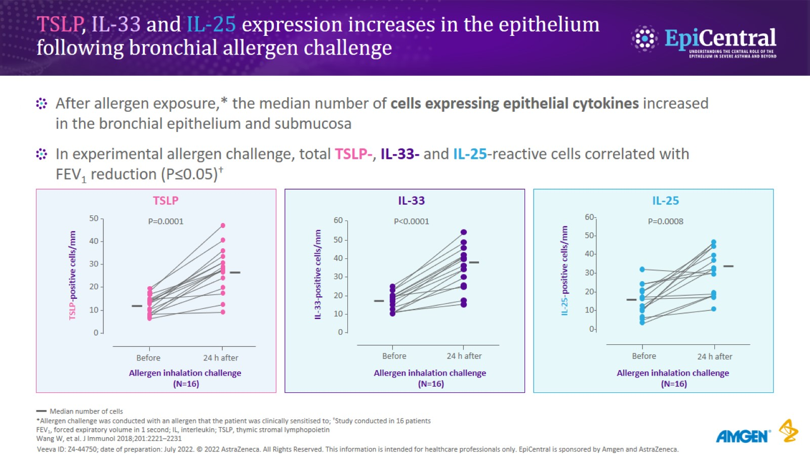
TSLP, IL-33 and IL-25 expression increases in the epithelium following bronchial allergen challenge

Slide 13
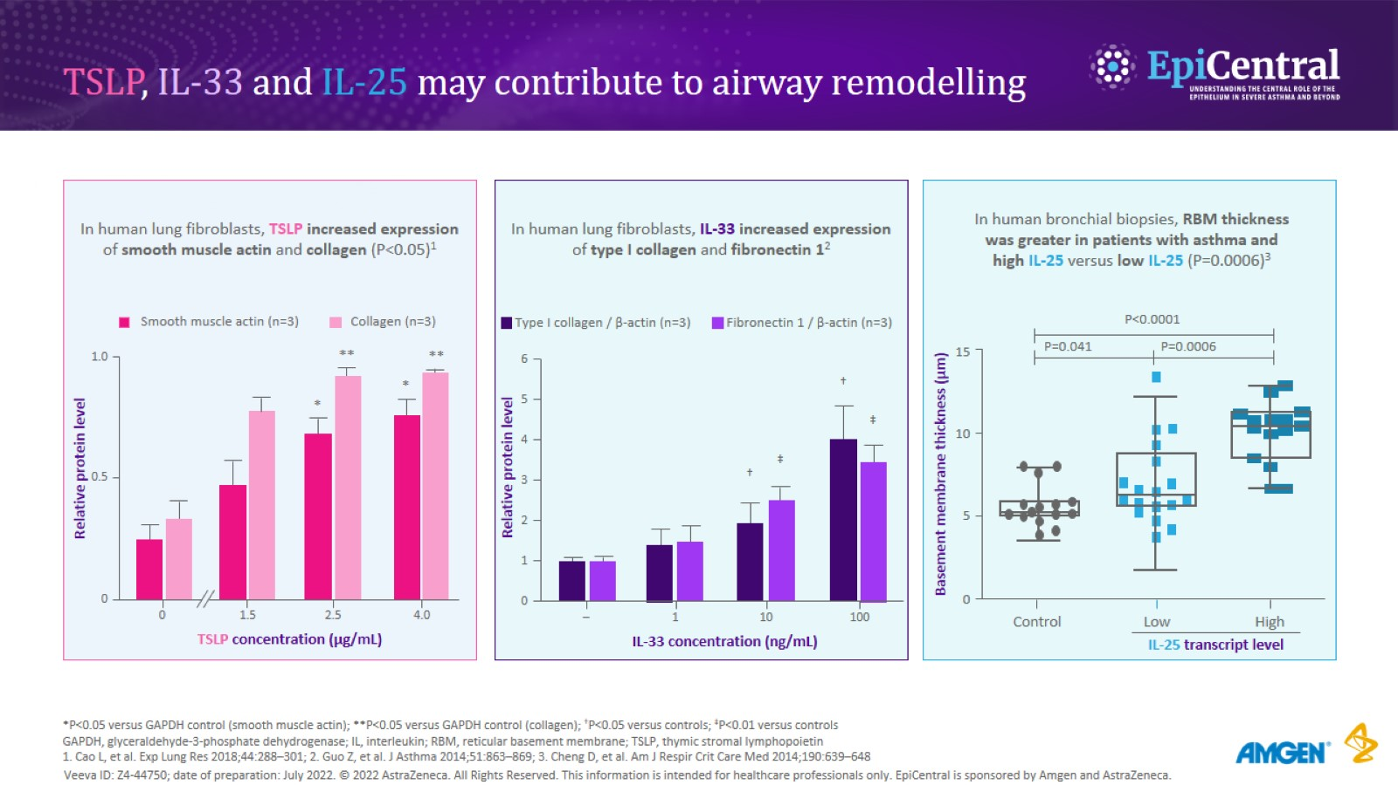
TSLP, IL-33 and IL-25 may contribute to airway remodelling

Slide 14
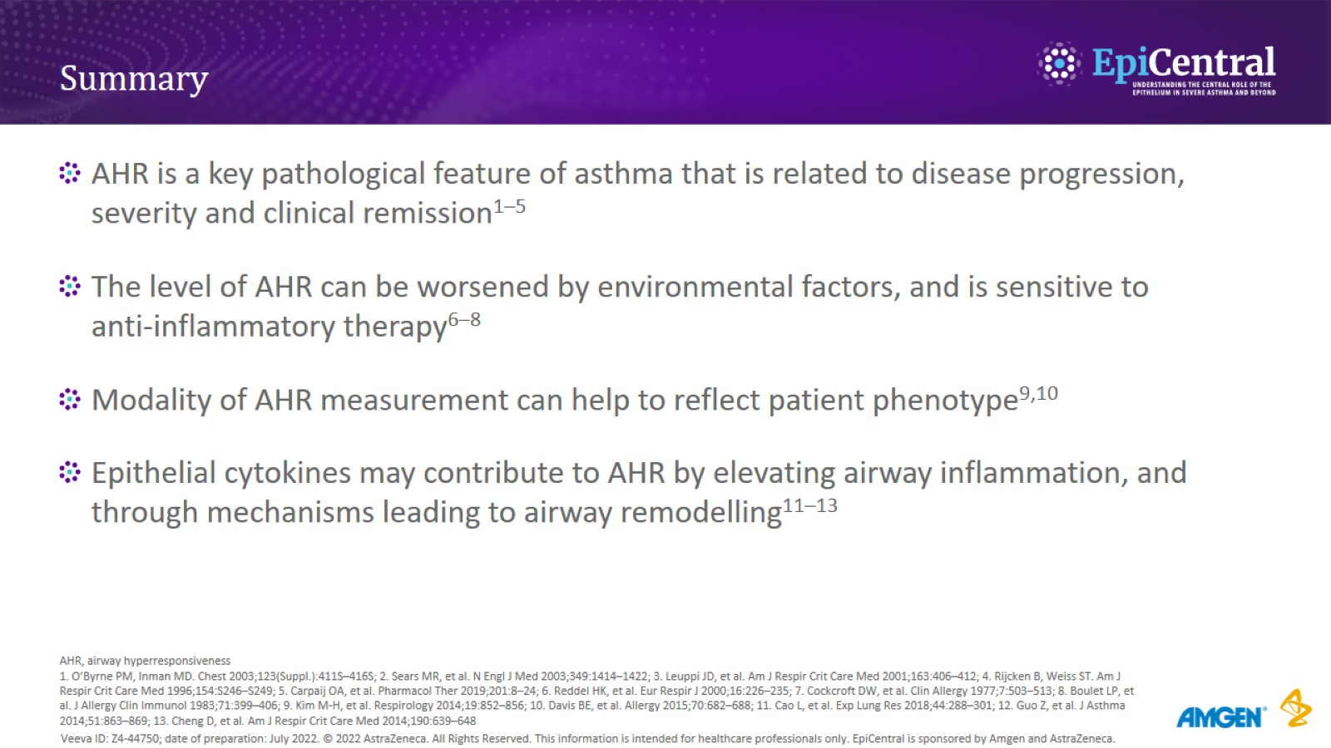
Summary

